Slide 1
Computer Organization & Architecture
The von Neumann Model
Chapter 4
Instructor: Dr. Baha Ihnaini

Slide 2
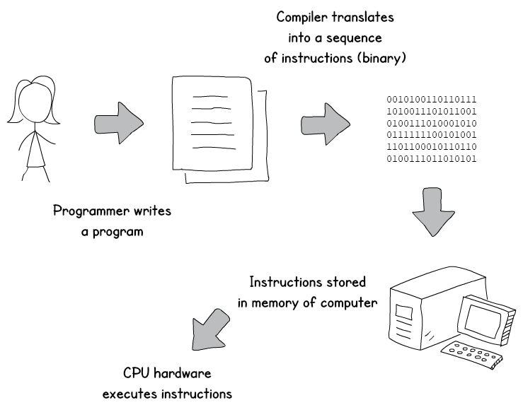
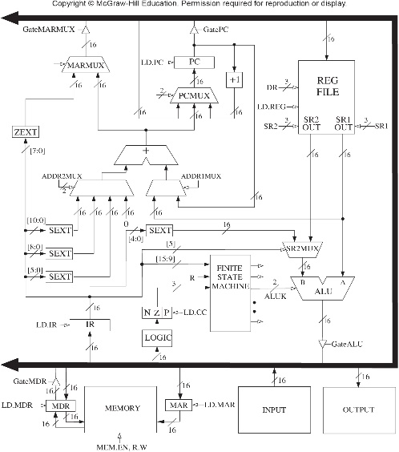
Solving a Problem using a Computer

Slide 3
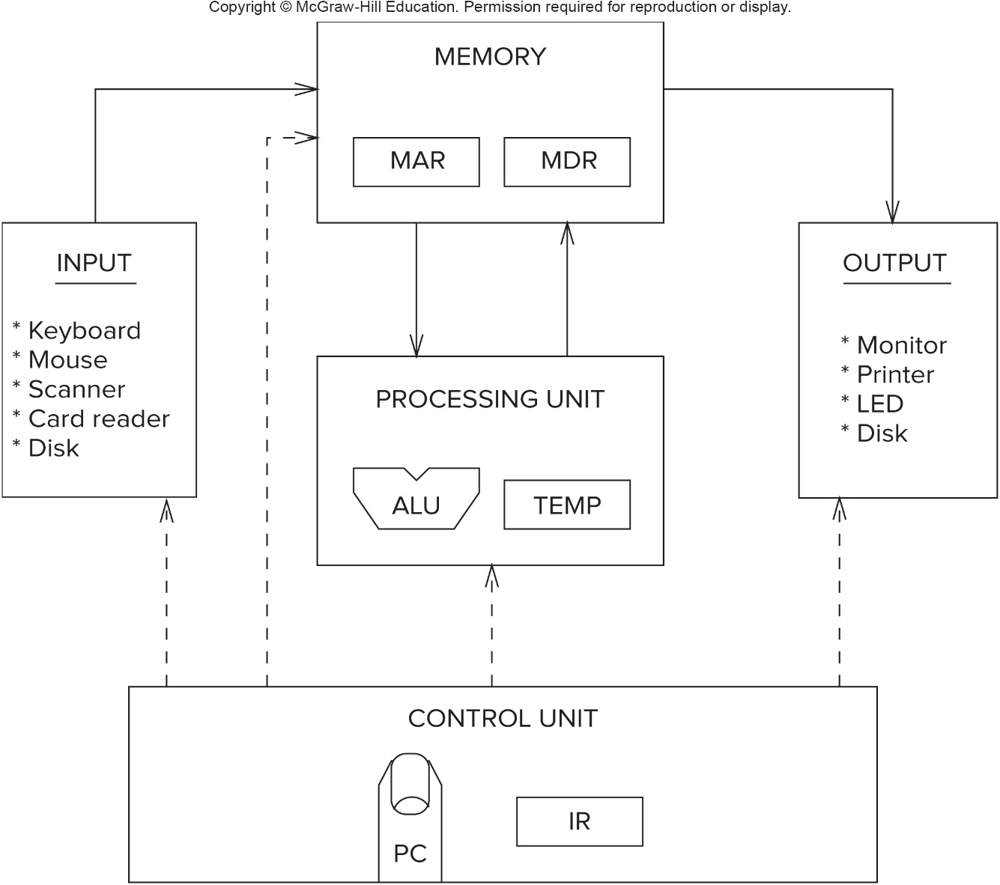
Computer Organization: von Neumann Model 1
Fundamental model of a computer proposed by John von Neumann in 1946

Slide 4
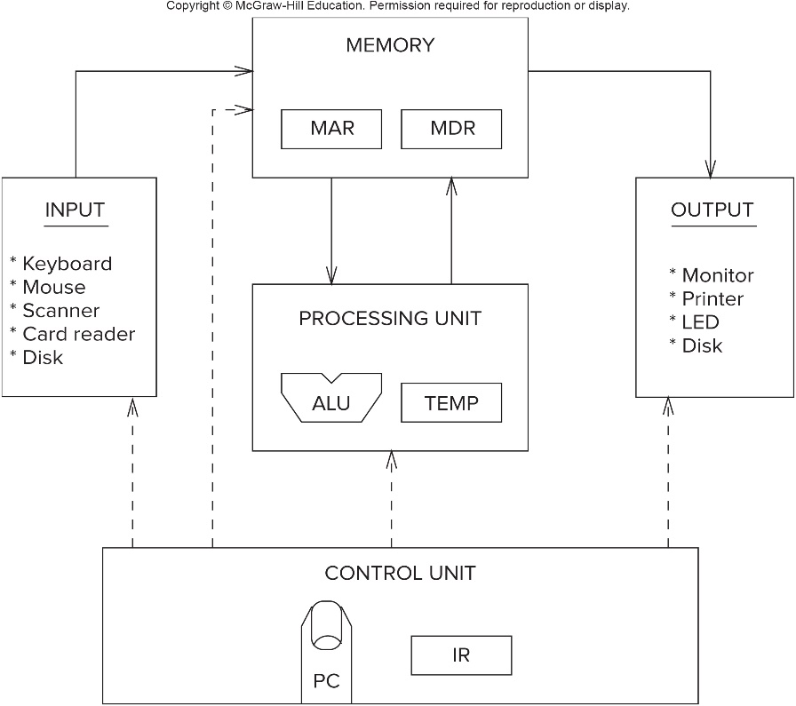
Computer Organization: von Neumann Model 2
Memory: stores data and instructions during program execution.
Processing Unit: transforms data -- logic circuits, temporary storage.
Control Unit: orchestrates fetching of instructions (from memory) and execution of instructions (in processing unit).
Input: receives data from external environment.
Output: sends data to external environment.
Processing Unit + Control Unit = C P U: Central Processing Unit.

Slide 5
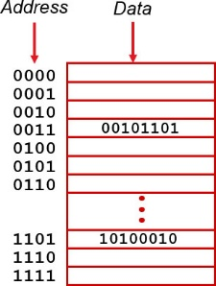
Memory
Address space = number of locations
locations means n-bit address.
Addressability = number of bits in each location
Basic operations
LOAD data from memory to C P U.
STORE data from C P U to memory.

Slide 6
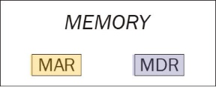
Interface to Memory
Registers used to move data into and out of memory
M A R = Memory Address Register
M D R = Memory Data Register
To LOAD data from memory:
Write the address into the M A R.
Send a "read" signal to memory.
Read data from M D R.
To STORE data to memory:
Write the address into the M A R.
Write the data into M D R.
Send a "write" signal to memory.

Slide 7
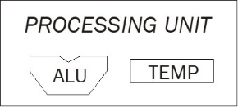
Processing Unit
Functional Units
Perform data transformations.
A L U = Arithmetic / Logic Unit add, subtract, AND, ...
Registers
Temporary storage of data.
Word Length
A L U operations are usually performed on words.
Typical word length: 64 bits (Intel Core), 32-bit (Intel Atom), 16 bits (LC-3).

Slide 8

Control Unit
Orchestrates the rest of the computer to carry out program instructions
Instruction Register (I R) holds the current instruction.
Program Counter (P C) holds the memory address of the next instruction to be executed. It is known as a "pointer" because it points to a memory location.
Control unit is a state machine that does the following:
Read (fetch) the next instruction from memory. (Address is in the P C.)
Sends control signals to other parts of processor to move / transform data according to the instruction.
Go to step 1, repeat forever...

Slide 9
Example Processor: L C-3
Memory = 2¹⁶ locations, 16 bits in each location
A L U: performs ADD, AND, NOT word length is 16 bits
Instruction length is 16 bits

Slide 10
Instruction
A computer instruction is a binary value that specifies one operation to be carried out by the hardware. It's binary, so it looks just like the data in Chapter 2 -- a collection of bits. The components of the instruction are encoded as various bit fields of the binary value.
Instruction is the fundamental unit of work. Once an instruction begins, it will complete its job.
Two components of an instruction:
opcode specifies the operation to be performed (for example: A D D)
operands specifies the data to be used during the operation
The set of instructions and their formats is called the Instruction Set Architecture (I S A) of a computer.

Slide 11
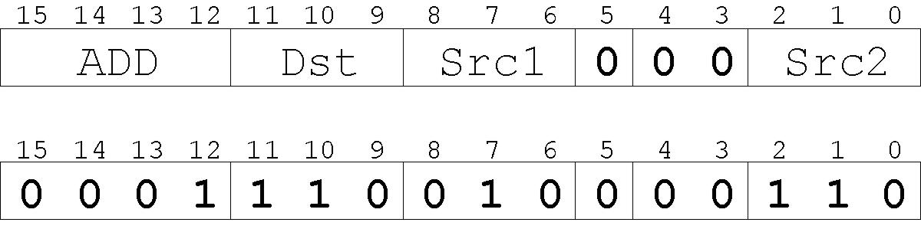
L C-3 Instruction
L C-3 has a four-bit opcode, bits [15:12] -- up to 16 different operations.
L C-3 has eight registers in the C P U. Registers are used as operands for instructions -- each operand requires 3 bits to specify which register.
Example: ADD instruction, opcode = 0001
“Add the contents of R2 (010) to the contents of R6 (110), and store the result in R6 (110).”

Slide 12
Types of Instructions
Instructions are classified into different types, depending on what sort of operation is specified.
Operate
Will perform some sort of data transformation
Examples: add, AND, NOT, multiply, shift
Data Movement
Move data from memory to a register in the CPU, or
Move data from a register to a memory location
Control
Determine the next instruction to be executed

Slide 13
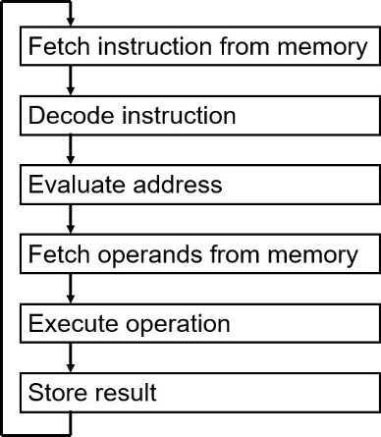
Processing an Instruction
The diagram shows the instruction cycle -- the set of steps that must be performed to execute each instruction.
The Control Unit is responsible for performing this sequence of actions.
Each step may require one more more clock cycles.

Slide 14
Instruction Cycle: FETCH
F
Load next instruction (at address stored in PC) from memory into Instruction Register (IR).
MAR ← (PC) ; use the value in PC to access memory
PC ← (PC) + 1 ; increment the value of PC
MDR ← Mem[MAR] ; read memory location to MDR
IR ← (MDR) ; copy (MDR) to IRDecode
D
EA
OP
EX
S

Slide 15
Instruction Cycle: DECODE
F
First identify the opcode.
In LC-3, this is always the first four bits of instruction.
A 4-to-16 decoder asserts a control line corresponding to the desired opcode.
Depending on opcode, identify other operands from the remaining bits.
Examples: For LDR, last six bits is offset. For ADD, last three bits is source operand #2
D
EA
OP
EX
S

Slide 16
Instruction Cycle: EVALUATE ADDRESS
F
For instructions that require memory access, compute address used for access.
Examples:
add offset to base register (as in LDR)
add offset to PC
add offset to zero
D
EA
OP
EX
S

Slide 17
Instruction Cycle: FETCH OPERANDS
F
Obtain source operands needed to perform operation.
Examples:
load data from memory (LDR)
read data from register file (ADD)
D
EA
OP
EX
S

Slide 18
Instruction Cycle: EXECUTE
F
Perform the operation, using the source operands.
Examples:
send operands to ALU and assert ADD signal
do nothing (e.g., for loads and stores)
D
EA
OP
EX
S

Slide 19
Instruction Cycle: STORE RESULT
F
Write results to destination. (register or memory)
Examples:
result of ADD is placed in destination register
result of memory load is placed in destination register
for store instruction, data is stored to memory
write address to MAR, data to MDR
assert WRITE signal to memory
D
EA
OP
EX
S

Slide 20
Instruction Processing: Fetch
Fetch
P C contains the address of the instruction to be fetched.
The control unit writes the P C value into the M A R to read the instruction stored at that location.
It also increments the P C to point to the next consecutive memory location. (It is assumed that the next instruction is stored in the next location in memory. This could be changed when the instruction is executed -- see "control instructions" later in this chapter.)
When the instruction is retrieved from memory (via the M D R), it is copied into the instruction register (I R).

Slide 21
Instruction Processing: Decode
Decode
Once the instruction is in the I R, the control unit "looks at" the opcode to determine what operation should be performed.
One possibility: a 4-bit decoder sets a particular control signal to 1, corresponding to the desired operation.
The opcode also determines how the other instruction bits should be interpreted.
For example: for ADD, bits [8:6] specify a register to be used as the first operand of the addition.

Slide 22
Instruction Processing: Executing the Instruction
Evaluate Address
For memory instructions, determine which address to load/store.
Fetch Operands
Get data values from registers and/or memory.
Execute
Perform the necessary operations (for example: add).
Store Result
Write the result of the computation to a register or to memory.
Not every step is required for every instruction. For example, if there is no memory access, then the Evaluate Address step is not performed.

Slide 23
Changing the Sequence of Instructions
In the Fetch step, we incremented the P C to point to the next instruction.
Sometimes, we want to execute a different instruction, not the next one in memory. This is the job of a control instruction.
A control instruction may change the P C value. In other words, instead of pointing to the next place in memory, a new address can be calculated and stored in the P C register.
This change may be conditional – for example: if the last value calculated was zero, write a new value to the P C. These are typically called branch instructions.
The change may be unconditional -- it always happens. These instructions are usually called jump instructions.
L C-3 control instructions will be explained in Chapter 5.

Slide 24
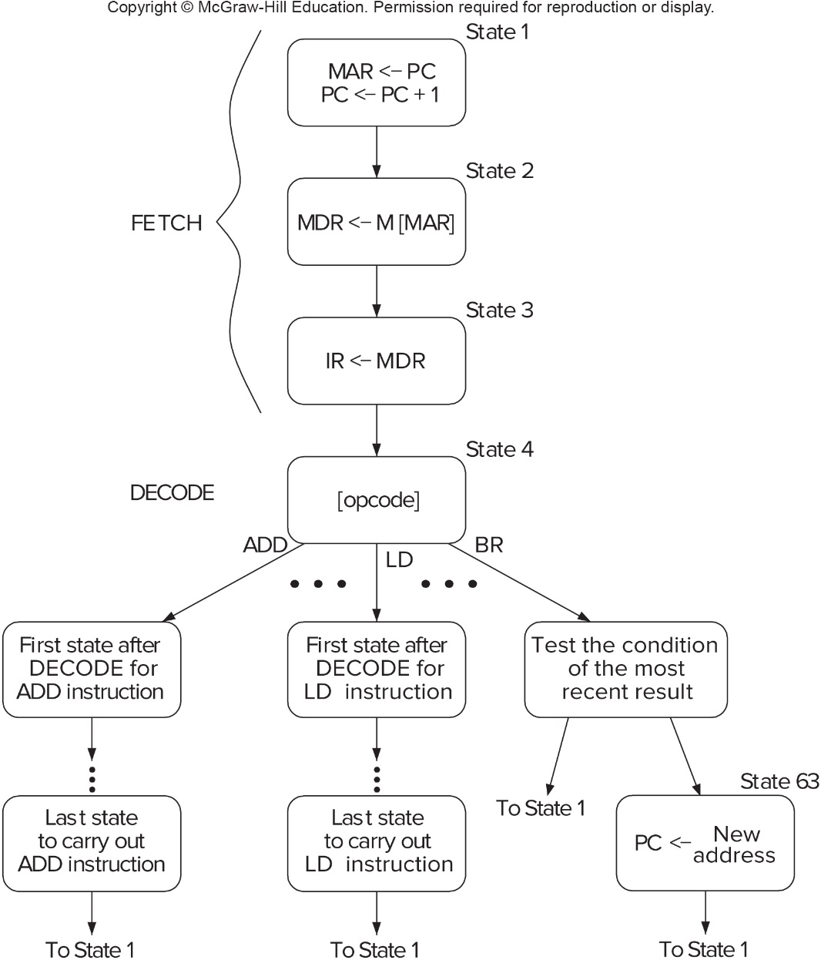
Control of the Instruction Cycle
The control unit is a state machine. A partial state diagram is shown below.
The instruction cycle starts with State 1, which initiates the Fetch phase. This is done for every instruction.
After the Decode phase (State 4), the states will depend on the specific opcode.
Appendix C has a complete description of the L C-3 state machine.

Slide 25
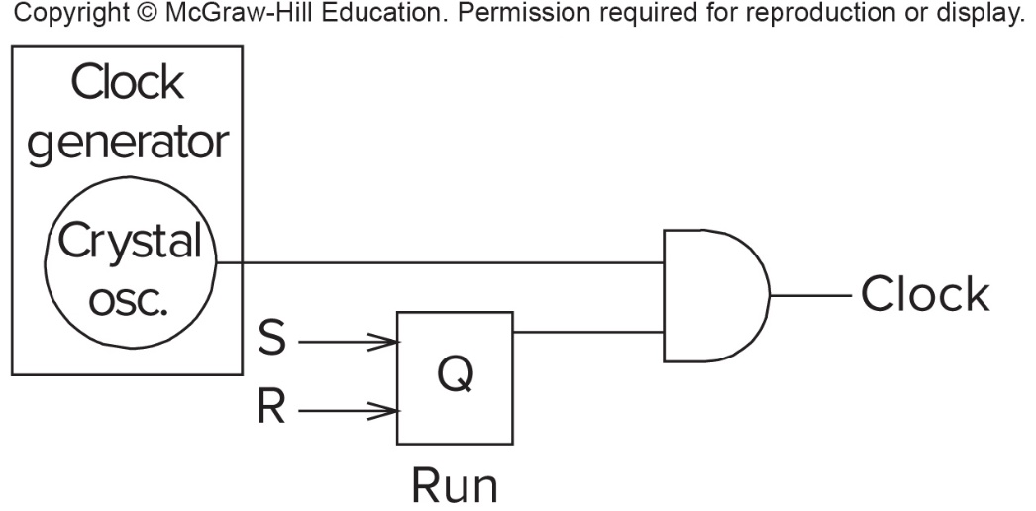
Stopping Execution
The control unit's state machines keeps running, as long as the clock signal keeps going up and down.
The program can halt execution by turning off the clock signal.
In the circuit above, we "gate" the clock signal using a bit stored in the latch. If the control unit sets that bit to zero, the clock will stop.
In some machines, this is done by a HALT instruction. In L C-3 (and others), the latch is part of a special register controlled by the operating system.

Slide 26
Chapter Summary
Computer program is specified by a sequence of instructions, stored in the computer's memory.
Each instruction is a bit pattern that specifies an operation to be performed. Different processors encode this information in different ways.
Combinational and sequential logic is used to retrieve instructions and data from memory, transform data according to the instructions, and write the results back to memory.
The control unit is a state machine, driven by a clock signal. It uses the Program Counter (P C) to step through the instructions in memory, fetching and executing each instruction.
All of this machinery is implemented using the digital logic structures discussed in Chapter 3.

